Slide 1
Speaker Recognition Using K-Nearest Neighbors and MFCC Features
Hamza Zamani, Taishi Kato, David Rosenwasser
M214A – Digital Speech Processing, Winter 2019
3/9/2019

Slide 2
Overview
Block Diagram
MFCCs and Feature Extraction
K-NN and Final Results
Alternate Approach (Neural Networks)

Slide 3
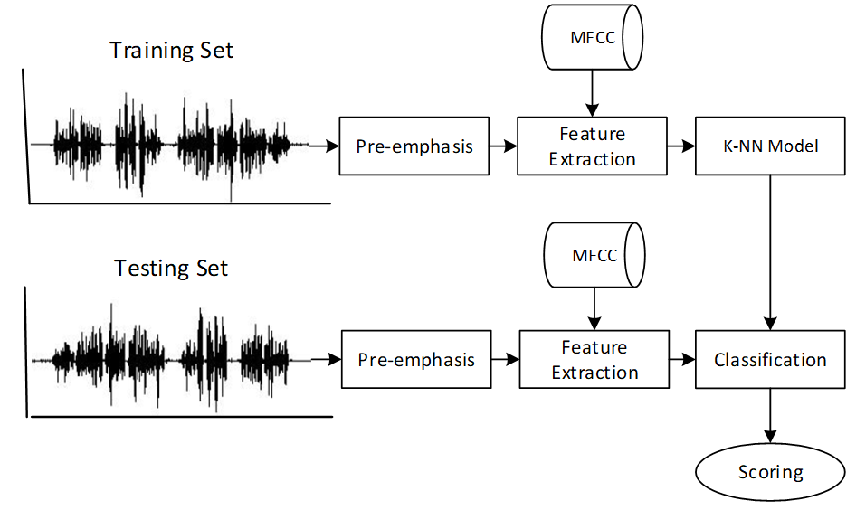
Block Diagram

Slide 4

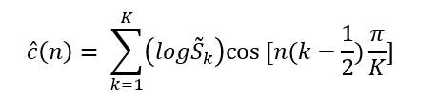

Mel-Frequency Cepstral Coefficients
Widely used feature for speech and speaker recognition
Operates in the mel-domain, a warped frequency representation modeled after the human auditory system
Log of Fourier spectrum
Mel-scale filter bank analysis
Discrete Cosine Transform (DCT)
$\tilde{S}$(k)
f

Slide 5
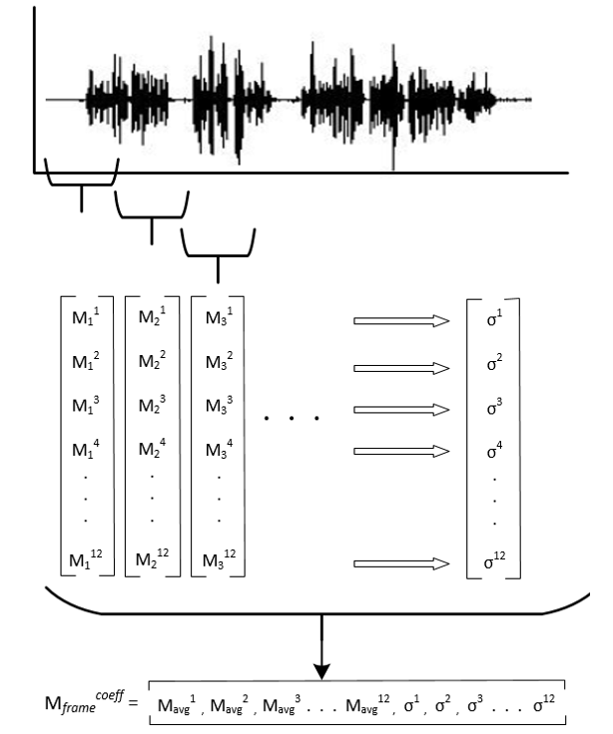
Feature Extraction
12 MFCCs
12 StdDeviations
Experimented with:
F0
Delta MFCC
Delta delta MFCC

Slide 6
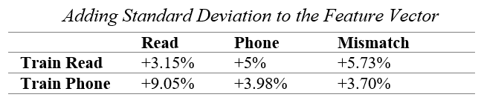
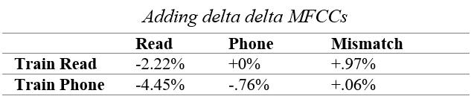
Feature Extraction Data
Removing F0, runtime went from 1516.22s to 30.25s

Slide 7
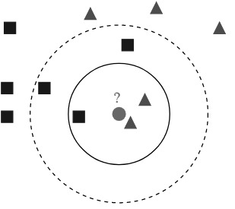
K-Nearest Neighbors
Feature representations are mapped across the KNN feature space
According to the defined parameters, the KNN will determine if the two speakers are the same or not

Slide 8
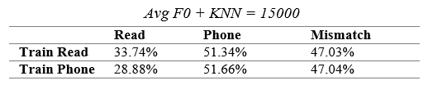
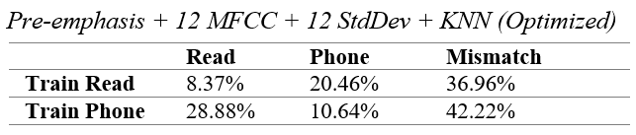
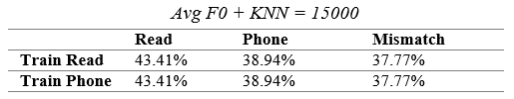

Results
Difficult to provide a robust model for both text-independent and text-dependent cases
Old Data
New Data

Slide 9
Neural Network
Alternate classification method explored
Modeled after the human neural system
Advantages
Classification in high dimensional feature spaces
Universal function approximation vs. statistical pattern matching

Slide 10
Neural Network Architecture
Feedforward Architecture
Easy to maintain
Relatively robust to noise
Architecture
24 neuron input layer
3 hidden layers
30 neurons per hidden layer
Single (binary) output layer

Slide 11
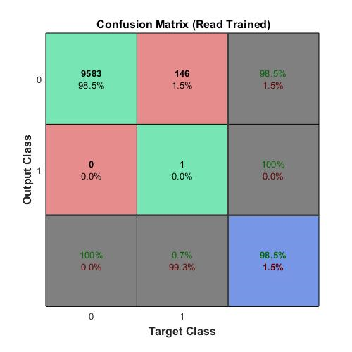

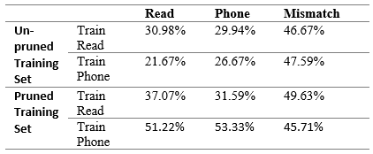
Neural Network Challenges
Limited training data
Over represented class biases the network
Data pruning techniques to artificially balance data
Reduced training set further leading to worse performance

Slide 12
Thank You

